Slide 1

Blazor in .net 8

Slide 2
Agenda
New Feature
Blazor Web App
Introduction
Render Mode
LifeCycle
PreRender
Webcil packaging

Slide 3
New Features
Feature | Detail | Hosting Support
 |  | Web | WebAssembly | Server(7.0)
Form | AntiforgeryToken | ✔️ | ✔️ | ✔️
 | SupplyParameterFromFormAttribute | ✔️ | ✔️ | ✔️
 | Enhanced form handling | ✔️ | ✔️ | ✔️
DataBinding | Two way binding: @bind:get/set | ✔️ | ✔️ | ✔️
Stream Rendering | StreamRenderingAttribute | ✔️(Server) | ❌ | ❌
Error Page | Default errorpage: /Pages/Error.razor | ✔️ | ❌ | ✔️
Route to named elements | Navigation.NavigateTo("/counter#targetElement"); | ✔️ | ✔️ | ✔️
Webcil packaging | Published with .wasm instead of .dll file | ✔️(WebAssembly) | ✔️ | ❌
Handle errors | Use ComponentBase.DispatchExceptionAsync | ✔️ | ✔️ | ✔️
 | Use IHostEnvironment | ✔️ | ❌ | ✔️
WebAssembly Runtime | Configure the .NET WebAssembly runtime | ✔️(WebAssembly) | ✔️ | ❌
Dialog | Support for dialog cancel and close events | ✔️ | ✔️ | ✔️

Slide 4
New Features
Feature | Detail | Hosting Support
 |  | Web | WebAssembly | Server(7.0)
Quick Grid | Blazor QuickGrid component from .net 7 | ✔️ | ✔️ | ✔️
Render outside asp .net core | Render Razor components outside of ASP.NET Core
Identity UI | generating a full Blazor-based Identity UI | ✔️ | ❌ | ❌

Slide 5
Blazor Web App
Introduction
Render Componment:
Comparing with Blazor Server and Blazor WebAssembly,Blazor Web Apps is a full-stack application mixed with server-side and client-side rendering modes.
https://learn.microsoft.com/en-us/aspnet/core/blazor/components/render-modes?view=aspnetcore-8.0

Slide 6
Blazor Web App
Render Mode
Static render mode
The Static render mode is the default render mode without configure @rendermode and can’t enable interactivity and stream
Server render mode
The Server render mode renders the component interactively from the server using Blazor Server
WebAssembly render mode
The WebAssembly render mode renders the component interactively on the client using Blazor WebAssembly
Auto render mode
The component is initially rendered server-side with interactivity using the Blazor Server hosting model. The .NET runtime and app bundle are downloaded to the client in the background and cached so that they can be used on future visits. Components using the automatic render mode must be built from a separate client project that sets up the Blazor WebAssembly host.

Slide 7
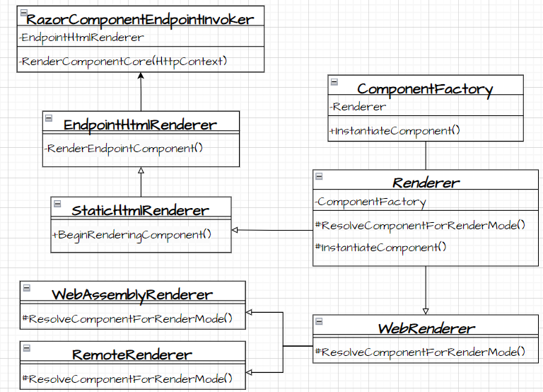
Blazor Web App
Render Mode
Render Componment:
RazorComponentEndpointInvoker.cs
RazorComponentEndpointInvoker.RenderComponentCore()
1. Initialize StreamingRendering Framing
2. Initialize Standard Component Services
3. Render Endpoint Component
3.1 InstantiateComponent
3.1.1 ResolveComponentForRenderMode
3.2 Waiting for quiesence(none stream Rendering) complete
4. write by HttpResponseStreamWriter

Slide 8
Blazor Web App
Render Mode
Render Componment:
RazorComponentEndpointInvoker.cs
RazorComponentEndpointInvoker.RenderComponentCore ->
EndpointHtmlRenderer.InitializeStandardComponentServicesAsync
EndpointHtmlRenderer.RenderEndpointComponent->
BeginRenderingComponent->
ComponentFactory.InstantiateComponent
WaitForResultReady() wait for quiescence of the non-streaming subtrees
EndpointHtmlRenderer.PrerenderPersistedStateAsync ->
return ComponentStateHtmlContent with different PrerenderComponentApplicationStore
Write by HttpResponseStreamWriter

Slide 9
Blazor Web App
Create Component:
ComponentFactory.cs
ComponentFactory.InstantiateComponent
Renderer.ResolveComponentForRenderMode -> override by EndpointHtmlRenderer/WebAssemblyRenderer : WebRenderer / RemoteRenderer : WebRenderer
->IComponentActivator.CreateInstance ->Implement by DefaultComponentActivator
->PrerenderPersistedStateAsync
RazorComponentEndpointInvoker.RenderComponentCore ->
EndpointHtmlRenderer.RenderEndpointComponent->
…-> ComponmentFactory.InstantiateComponent

Slide 10
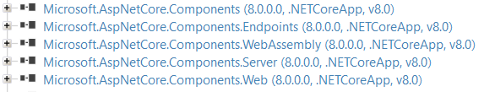
Blazor Web App
Render Mode

Slide 11
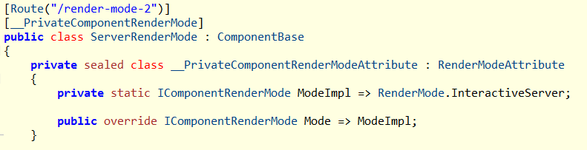
Blazor Web App
Render Mode
Component will generate a private __PrivateComponentRenderModeAttribute which distingulish the RenderMode:
@page "/render-mode-2"
@rendermode RenderMode.InteractiveServer
<h3>Server Render Mode</h3>

Slide 12
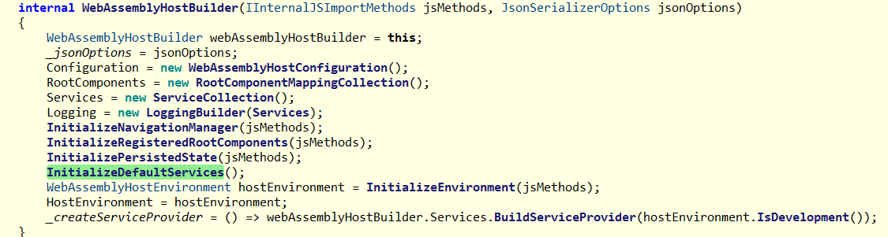
Blazor Web App
WebAssemblyHostBuilder.cs

Slide 13
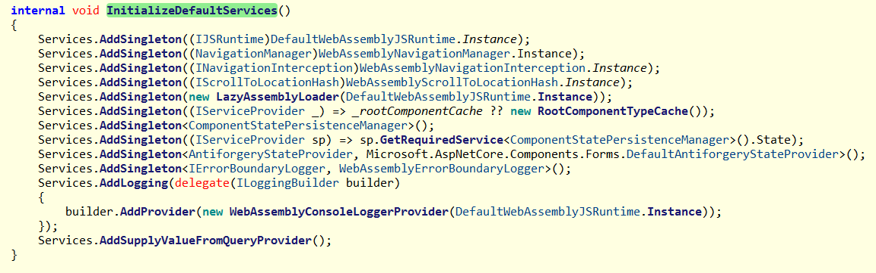
Blazor Web App

Slide 14
WebApplicationBuilder
Blazor.web hosting:
WebApplicationBuilder.Services.AddRazorComponents()

Slide 15
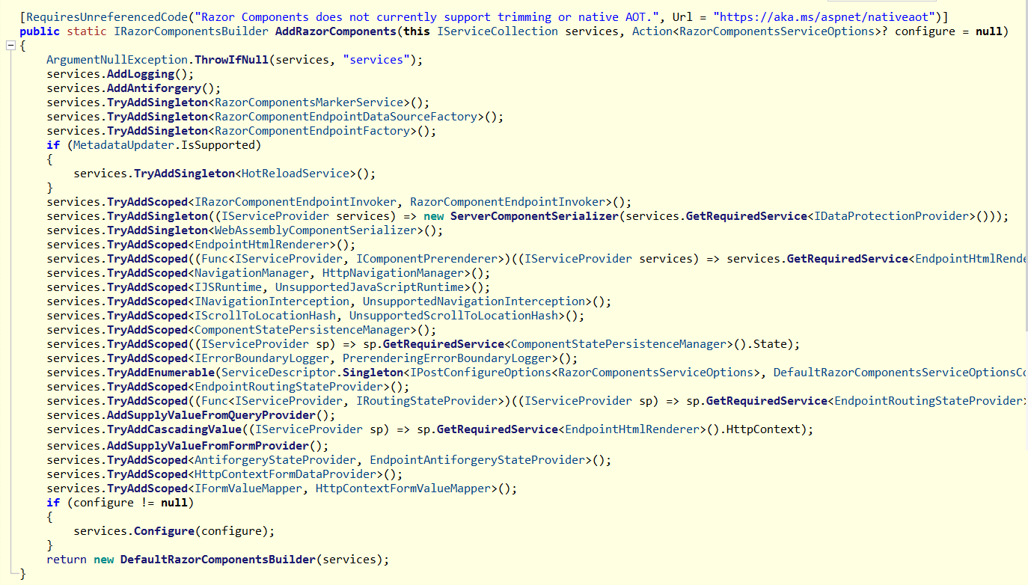

Slide 16
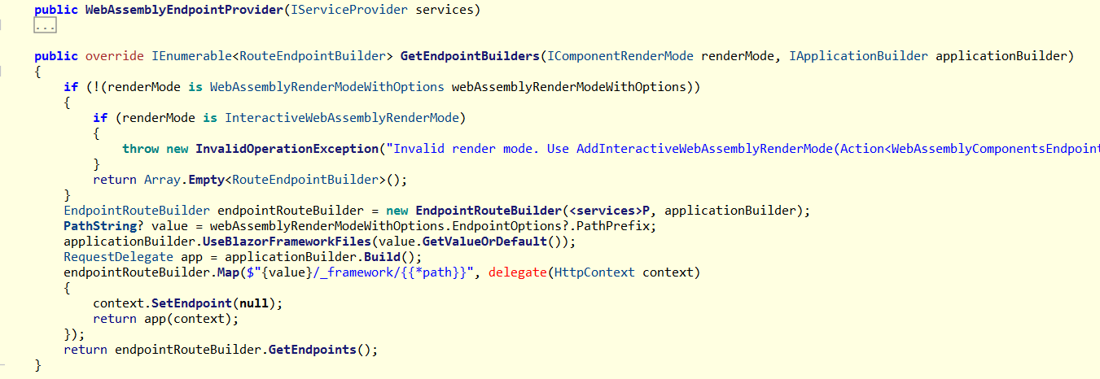
WebApplicationBuilder
AddInteractiveWebAssemblyComponents

Slide 17
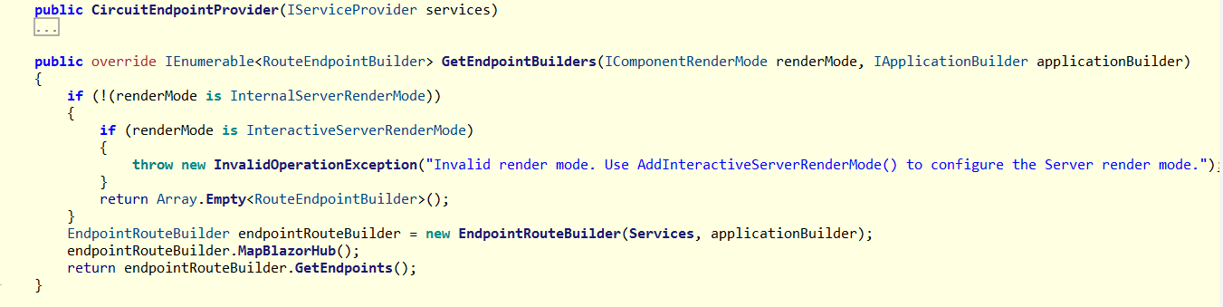
AddInteractiveServerComponents

Slide 18
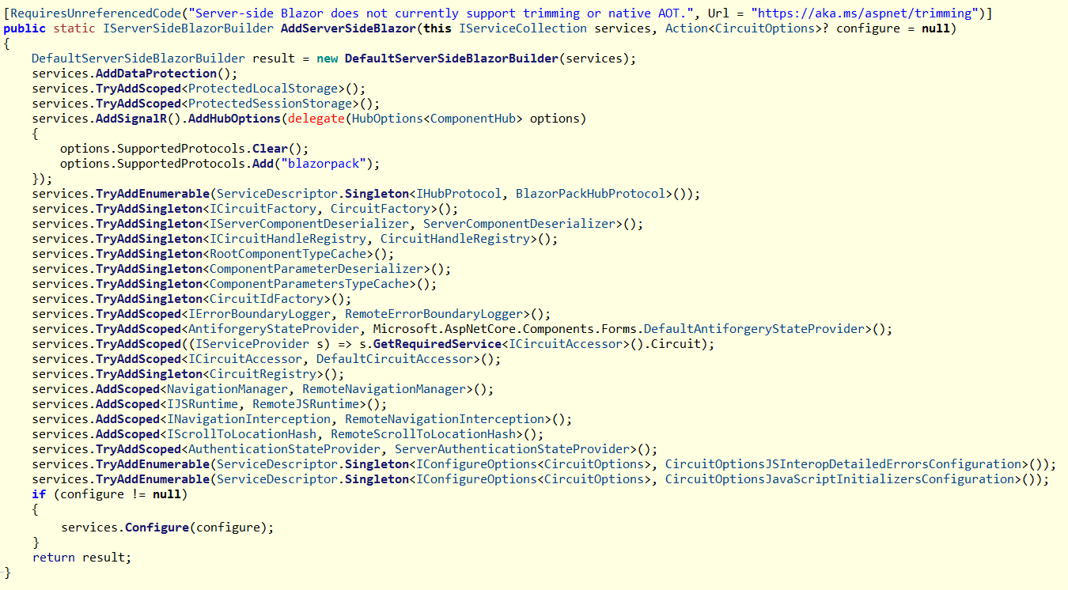

Slide 19
Life Cycle
ASP.NET Core Razor component lifecycle
Blazor Server/WebAssembly .net 6.0/8.0 | Blazor Web .net 8.0 | Blazor Web WebAssembly .net 8.0 | Blazor Web Static .net 8.0
SetParametersAsync - Begin OnInitialized OnInitializedAsync OnParametersSet OnParametersSetAsync SetParametersAsync - End | SetParametersAsync - Begin OnInitialized OnInitializedAsync OnParametersSet OnParametersSetAsync SetParametersAsync - End SetParametersAsync - Begin OnInitialized OnInitializedAsync OnParametersSet OnParametersSetAsync SetParametersAsync - End | SetParametersAsync - Begin OnInitialized OnInitializedAsync OnParametersSet OnParametersSetAsync SetParametersAsync - End | SetParametersAsync - Begin OnInitialized OnInitializedAsync OnParametersSet OnParametersSetAsync SetParametersAsync - End

Slide 20
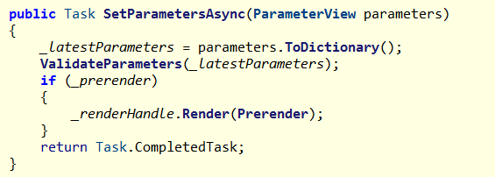
PreRender
Blazor apps that prerender their content on the server call SetParametersAsync twice
Prerender at SSRRenderModeBoundary.cs
Set @attribute [RenderModeInteractiveServer(prerender: false)] or @attribute [RenderModeInteractiveAuto(prerender: false)] will disable prerender

Slide 21
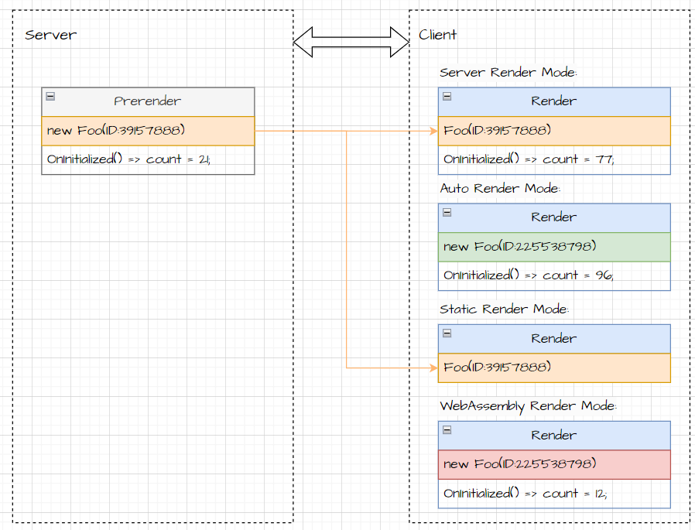
PreRender
Prerender at Server side

Slide 22
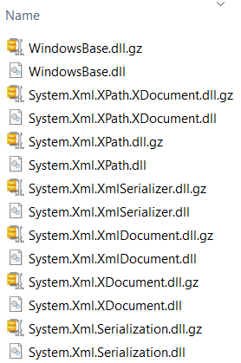
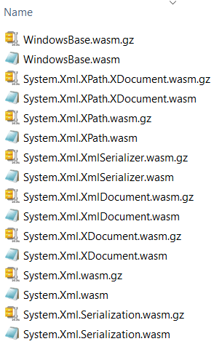
Webcil packaging
Webcil files use a standard WebAssembly wrapper, where the assemblies are deployed as WebAssembly files that use the standard .wasm file extension instead of .dll file.
.net 6.0
.net 8.0

